Slide 1




CYCLISTIC: TURNING POTENTIAL INTO LOYALTY
COURSERA CASE STUDY
Capstone project for the Google Data Analytics Professional Certificate
Presented by: Nguyen Mai
Last updated: February 4th 2026

Slide 2
Table of contents
01
02
03
Project objectives
Executive Summary
Overview Segments
04
05
06
Behavioral Deep-Dive
Summary and Conclusion
Business Suggestions

Slide 3


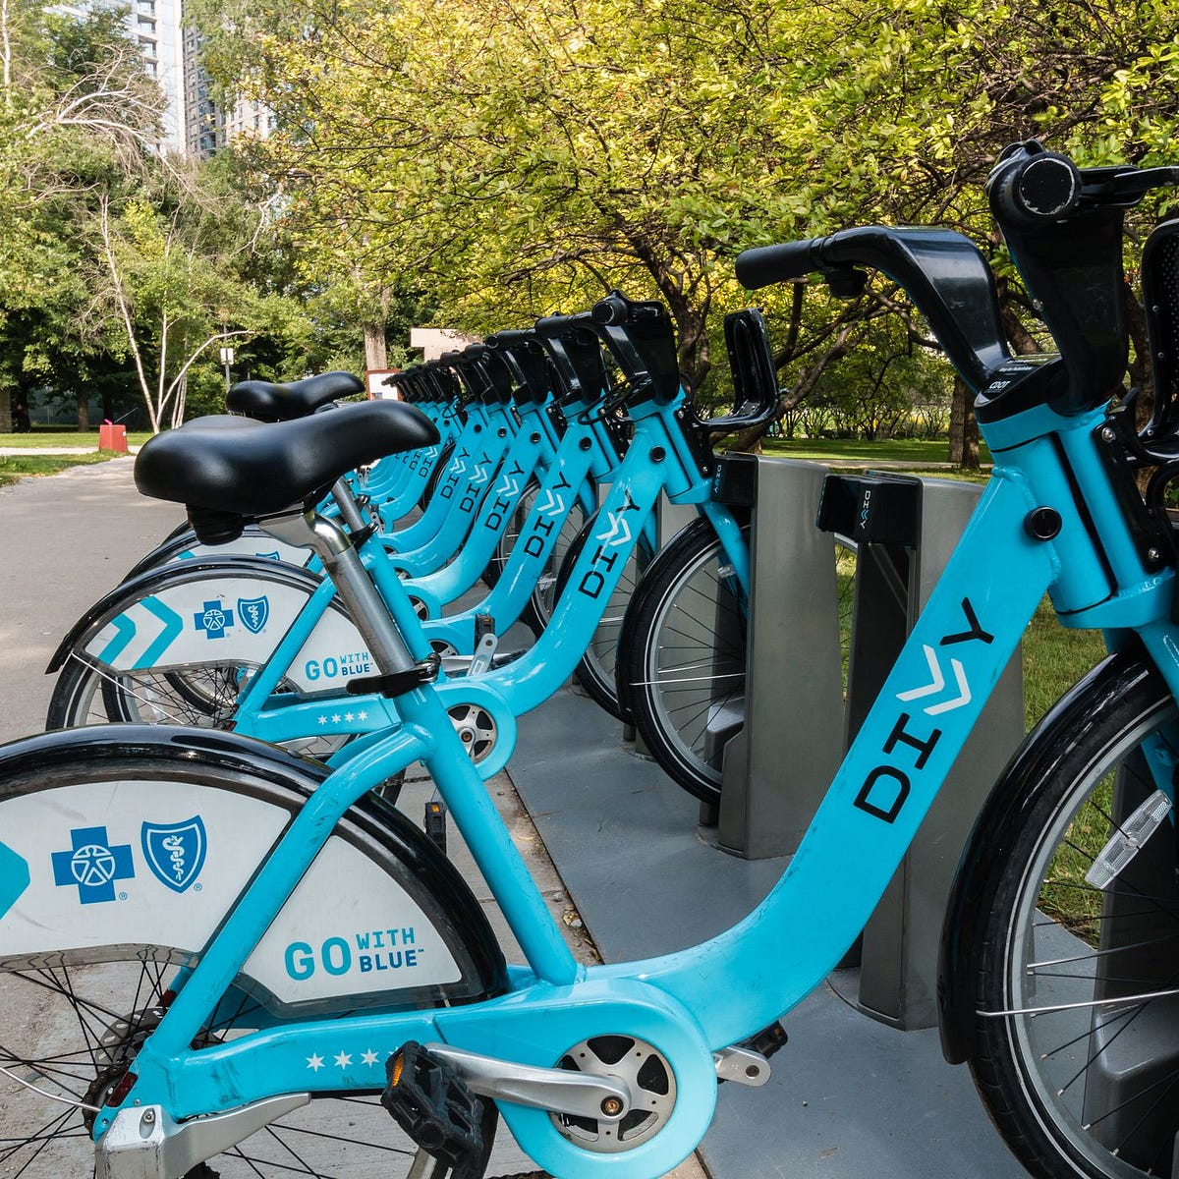
01.
Introduction and Project objectives

Slide 4


Introduction and Project objectives
1. The Business
2. Objectives
- Company overview: Cyclistic is a successful bike-share program with 5,800+ bikes and 600+ docking stations within Chicago
- Customer segments: Casual Riders and Annual Members
- Opportunity: Annual members are much more profitable than casual riders
- Business tasks:
Converting casual riders into annual members
Increase ….of total number of riders
This case study is part of the Google Data Analytics Professional Certificate. The analysis is based on public data to solve a business challenge for Cyclistic

Slide 5

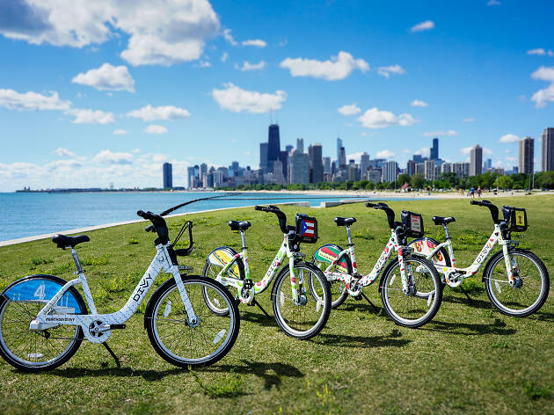
02.
Executive Summary
A high-level overview of key insights, data findings, and strategic recommendations

Slide 6



Executive Summary
Objectives
Key insights
Proposals
Analyze historical trip data to uncover distinct patterns between members and casual riders
Attract 10% more casual riders on top of the 2025 base (1.94 M)
Create data-backed marketing strategies to ensure 20% new customers enroll in the membership initially
Casual riders are weekend-usage centric, while annual members are stable users
Both casual riders and annual members prefer using electric bikes
Casual riders distribute near recreational areas, while members are everywhere
Develop an annual weekend membership
Create a reward system for using electric bikes
Carry out a 3-day membership free trial for new customers

Slide 7
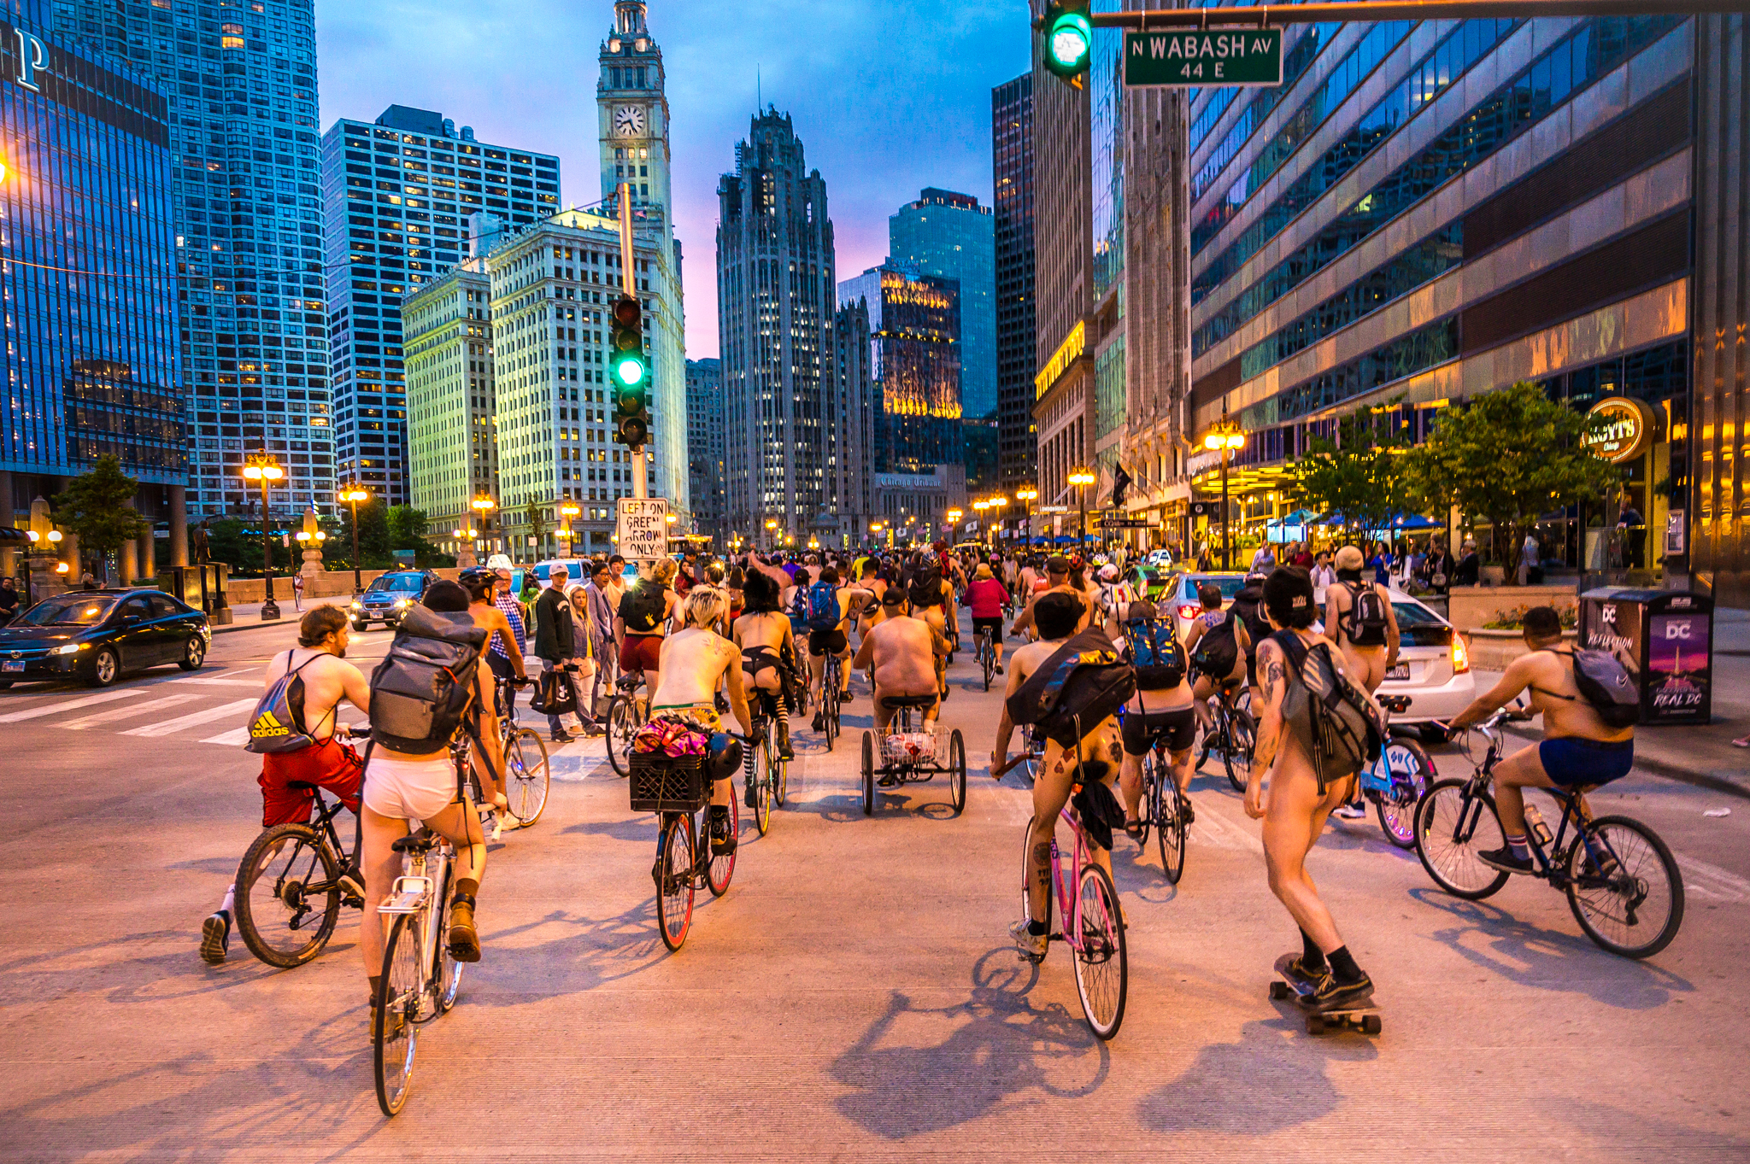
03.
Overview Segments

Slide 8


Overview segments
Commuters
Casual riders
The Daily Commuters use an annual membership for work and stable mobility
Account for 65% of the total rides
The Weekend Explorer uses single tickets for entertainment and flexible mobility
Account for 35% of the total rides

Slide 9

04.
Behavioral Deep-Dive
Determine and estimate how temporal factors, usage intensity, and geographic patterns shift the customer’s biking behaviors

Slide 10
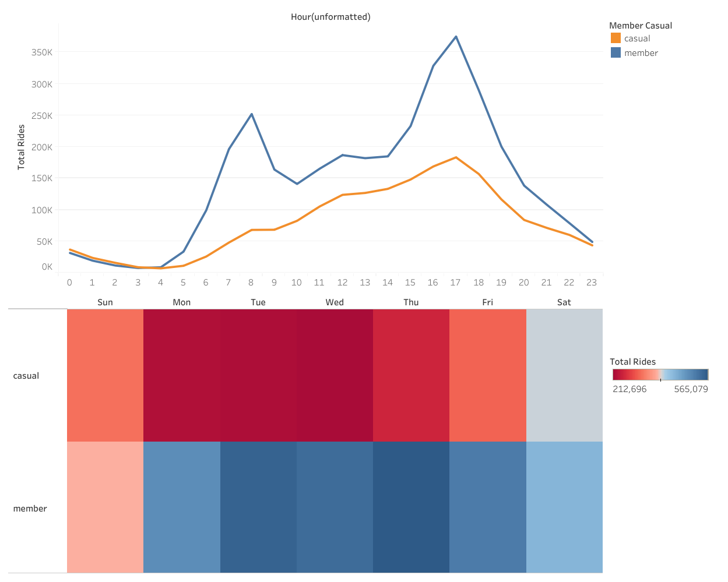
Temporal Aspects
The Rhythm of Life
Weekend Surge: Casual riders: leisure-oriented-> Annual Members: routine-oriented
Notable value: Members peak at 8 AM and 5 PM, while casual riders concentrate between 8 AM and 5 PM
Insight: Usage patterns reflect rider intention and lifestyle differences

Slide 11
Temporal Aspects
Seasonal Patterns
Summer Peak: Both casual riders and members are at their highest between Jun and July
Seasonal consistency: Casual riders fluctuate unpredictably, while members follow a stable trend year-round
Insight: Casual riders are seasonally sensitive, creating opportunities for summer promotions

Slide 12
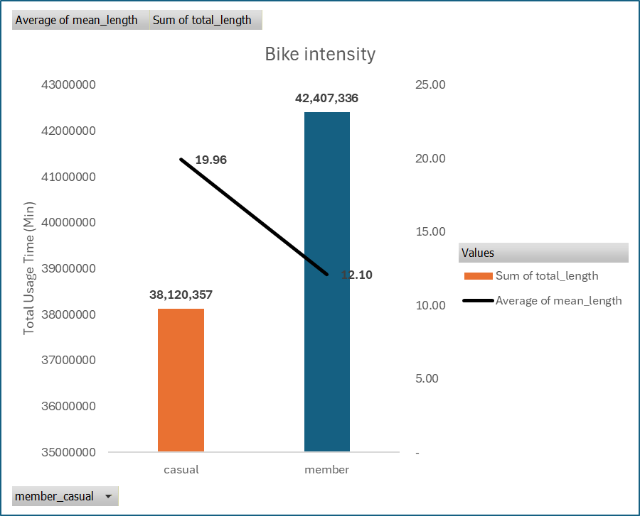
Usage Intensity
Metrics
Volume: Strong correlation between total rides and distribution of Members/Casuals
Engagement: Distinct usage intent affects the notable average length for biking
Insight: Casual riders show 0.9 times less total usage, but 1.6 times higher average value

Slide 13
Usage Intensity
Bike preferences
Tech-explorers: Both casual riders and members prefer electric bikes to classic bikes
High-Diff: There is an equal number of casuals’ electric bikes and members’ classic bikes
Insight: Casuals and members account for 65% and 63% respectively, reflecting the same preference

Slide 14
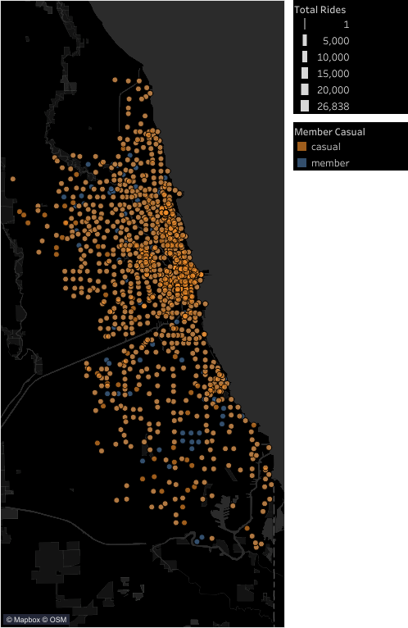
Geographic patterns
Locations
Distribution: While members distribute widely, casuals are highly clustered at recreational areas
Relationship: Strong correlation between geography and usage patterns
Insight: Members show a balanced distribution, while casuals populate near waterfronts

Slide 15

05.
Summary and Conclusions

Slide 16




Summary and Conclusions
1
2
3
4
Casual riders are seasonally sensitive, and peak on the weekends with a leisure-flexible schedule
Casual riders prefer electric bikes for leisure trips, showing strong engagement but lower total and higher average durations
Waterfronts and leisure hubs hold the majority of casuals, reinforcing the connection between ridership and recreational activities
Evidence suggests that temporal factors, usage intensity, and geographical patterns reveal a roadmap for digital marketing strategies

Slide 17
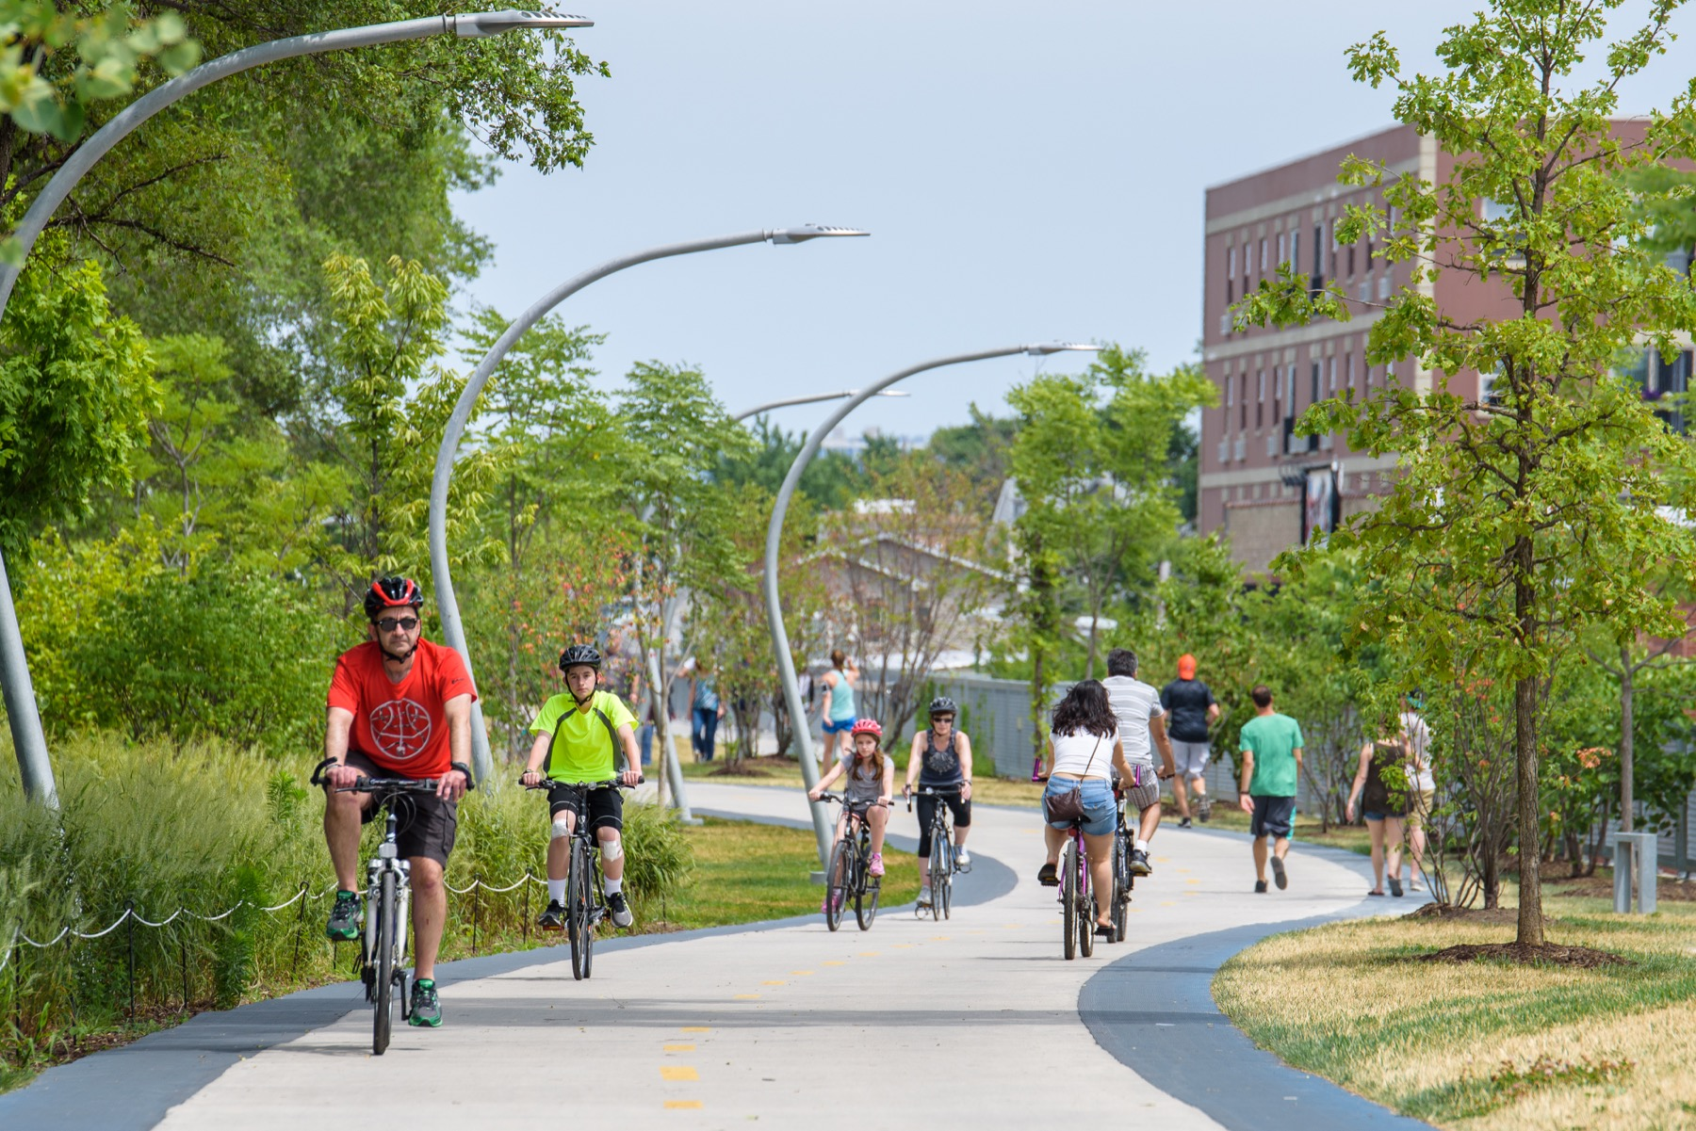
06.
Business Suggestions

Slide 18


Business Suggestions
1
2
3
Annual Weekend Membership: casuals are weekend-oriented => promoting “Personalized memberships” with targeted social media ads to create predictable revenue and increase customer retention, while meeting the riders’ demands
Reward system: Casuals lean toward electric bikes, implementing an in-app gamified reward system and creating green milestones to drive user retention and encourage membership conversion
3-day free trial: Operating a limited-time trial with Geofencing marketing plans at Waterfront stations for casuals to experience member-only perks without initial commitment, effectively convert spontaneous users into annual members

Slide 19
Thank You
I really appreciate your time!

